Slide 1
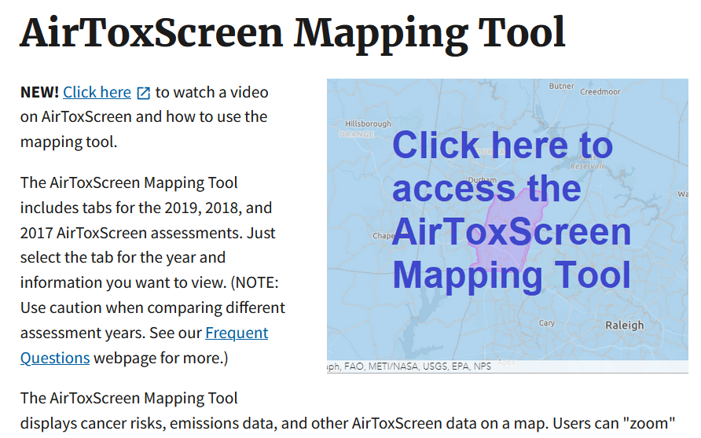
Atmospheric Flux
Rapporteur: Ben Runkle
Sept 26, 2023
NASA CMS PI Meeting

Slide 2
Atmospheric Flux: Stakeholder Issues
Dataset design: inventory measurements vs modeling objectives (the measurements are more impactful for stakeholders, help refine emission factors and reform inventories, inform treatment of extreme events, design pollution control mechanisms)
How to do stakeholder-relevant work:
Use science to improve & be ingested into EPA’s State Inventory Tool (SIT);
Comment on requests for information;
Engage US Climate Alliance network of states;
Create a GIS layer with hot spots for states to relate to factories, populations there;
Analog to AirToxScreen Mapping Tool but for GHGs
Confront different inventories or estimates against each other – especially in spatial or temporal disaggregation (e.g., site of sale vs. site of combustion, month by month emissions)
Needs:
Map of natural or dispersed emission sources and magnitudes,
Plan for future trajectory (model responses to policy scenarios)
Tracking carbon market sales or programs, on carbon budget via a registry
Notes:
Susan Thornlow EPA in NC
Stacy Knapp Maine
Stakeholder engagement strengths, gaps
Challenges and barriers for effective stakeholder engagement
Can we inform COP28? Interagency efforts?

